Slide 1


FINANCIAL
ANALYSIS
Github

Slide 2



Introduction to results analysis
The purpose of this analysis is to understand investor behavior across various demographics, investment avenues, and financial objectives. This analysis helps identify actionable insights that can guide product development, marketing strategies, and customer engagement efforts.
The data was collected from a sample of investors and includes information about their demographic details (age, gender), investment preferences, savings objectives, and sources of financial advice.
The analysis was performed using Tableau to create interactive dashboards that provide insights into investor preferences and trends.

Slide 3

DATA
METHODOLOGY
The dataset consists of investor demographic information, including age, gender, and investment behavior data, such as preferred avenues of investment (e.g., mutual funds, equities, bonds), investment duration, savings objectives, and sources of financial advice.
Data cleaning involved standardizing categorical values, ensuring consistency across the dataset, and creating new fields for analysis where necessary (e.g., binning age groups).
The approach focused on visualizing key insights through Tableau dashboards, covering investor demographics, investment preferences, savings objectives, and information sources.

Slide 4



VISUALISATION
ANALYSIS
Github

Slide 5
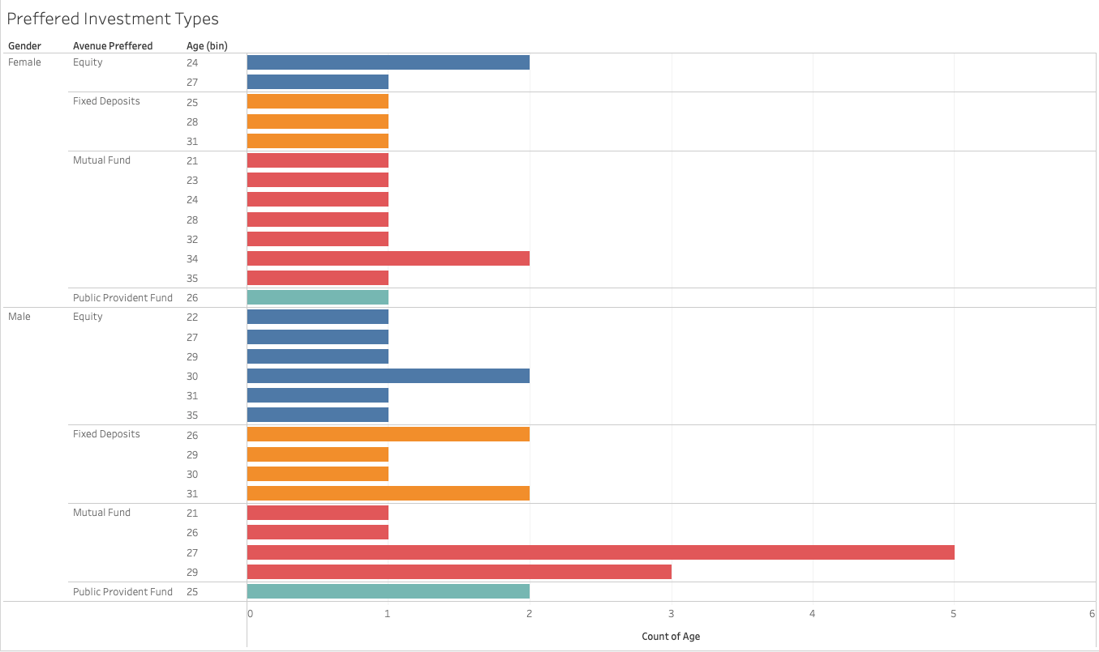

Slide 6
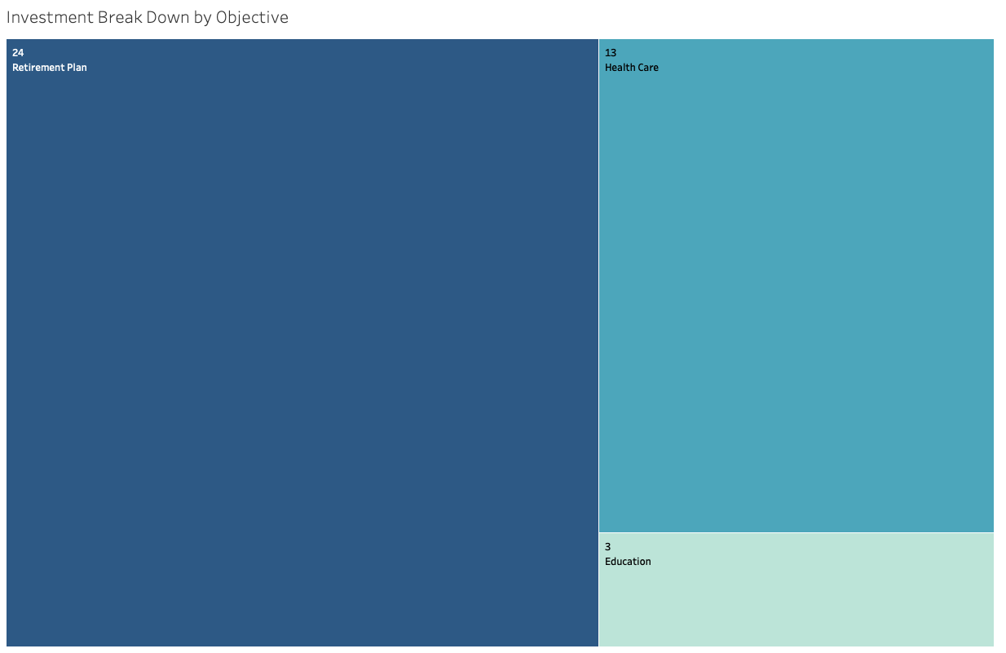

Slide 7
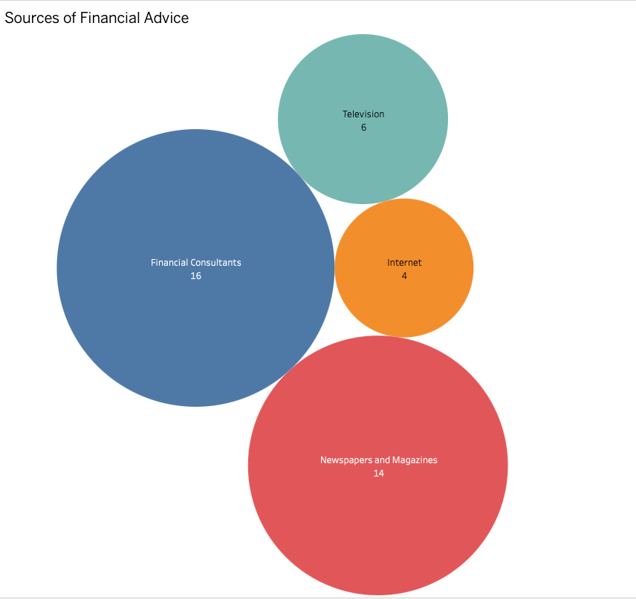

Slide 8
DASHBOARD
ANALYSIS
Github

Slide 9
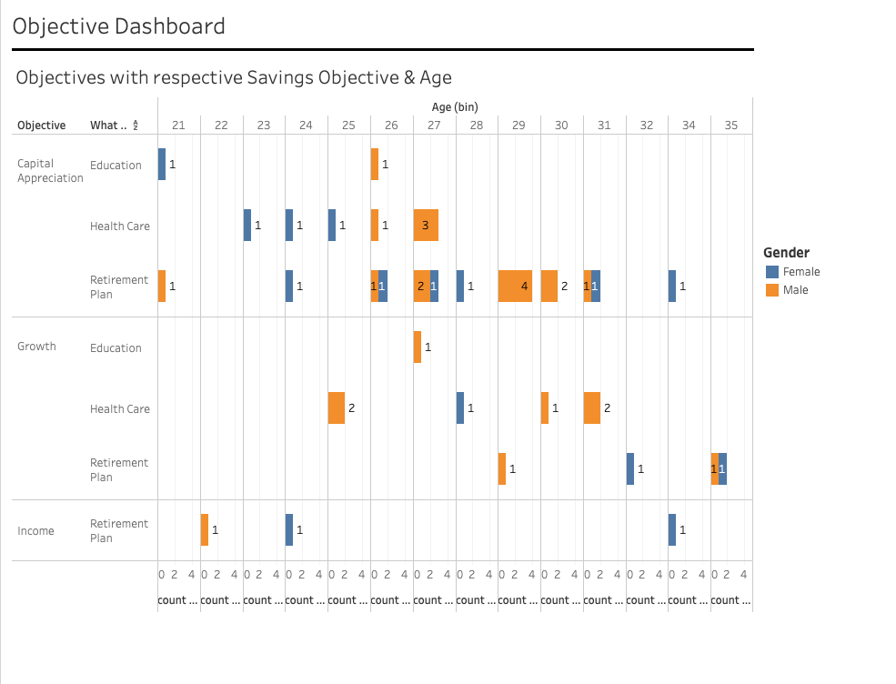

Slide 10
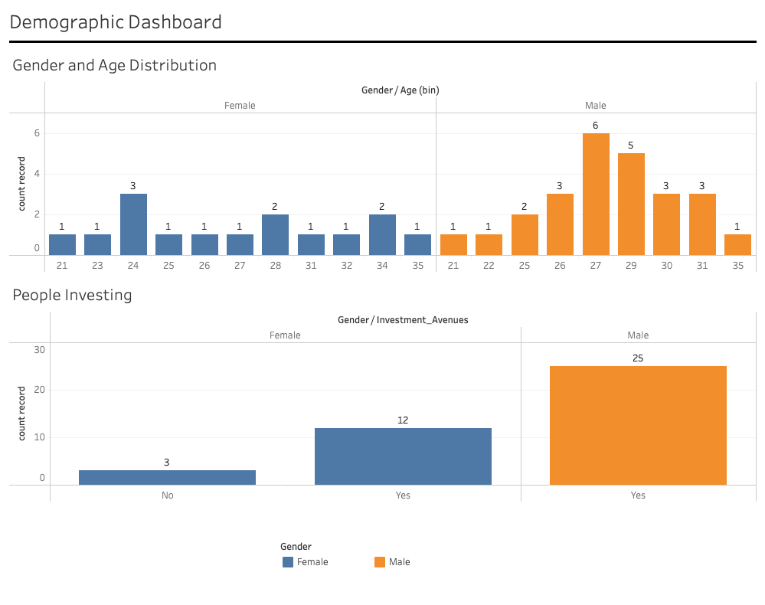

Slide 11
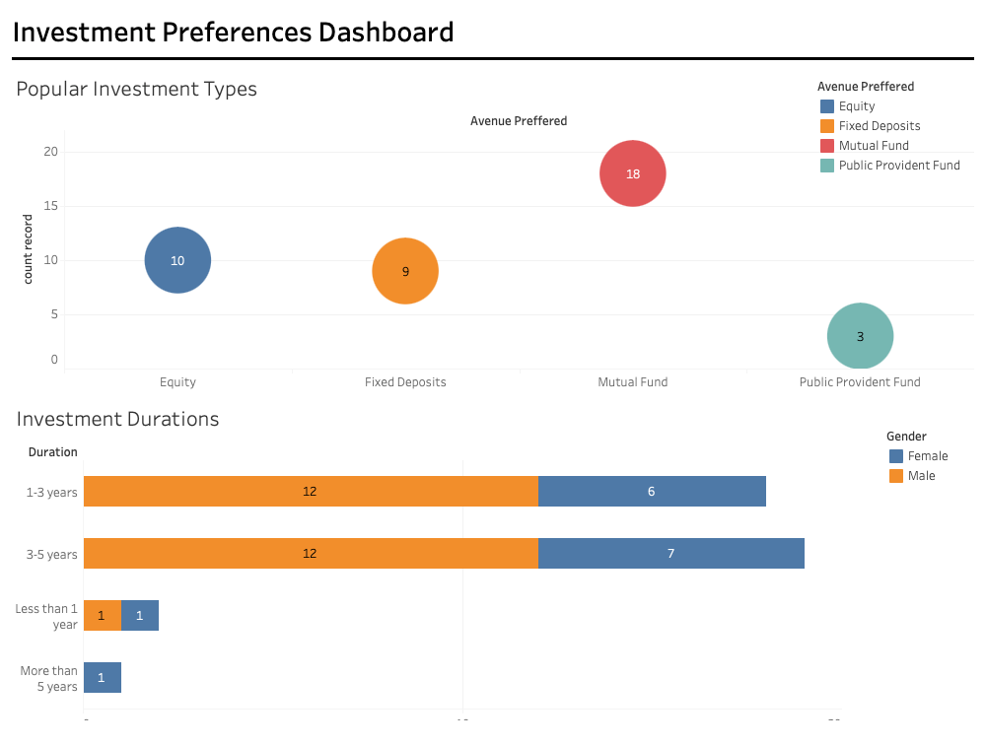

Slide 12
KEY INSIGHTS
Demographics & Investment Preferences
Investment Durations
Age and Gender Distribution: The dataset shows a gender distribution among investors, with males making up 62% and females 38%. Younger investors (aged 20-35).
Investment Avenues: Among younger investors (20-35), mutual funds and equities are the most popular choices.
The majority of younger investors prefer shorter-term investments (1-3 years),

Slide 13
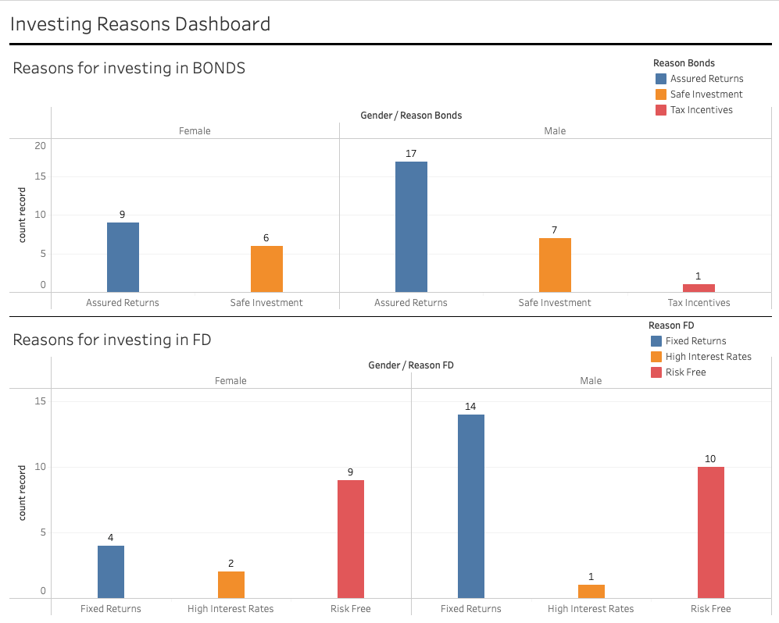

Slide 14
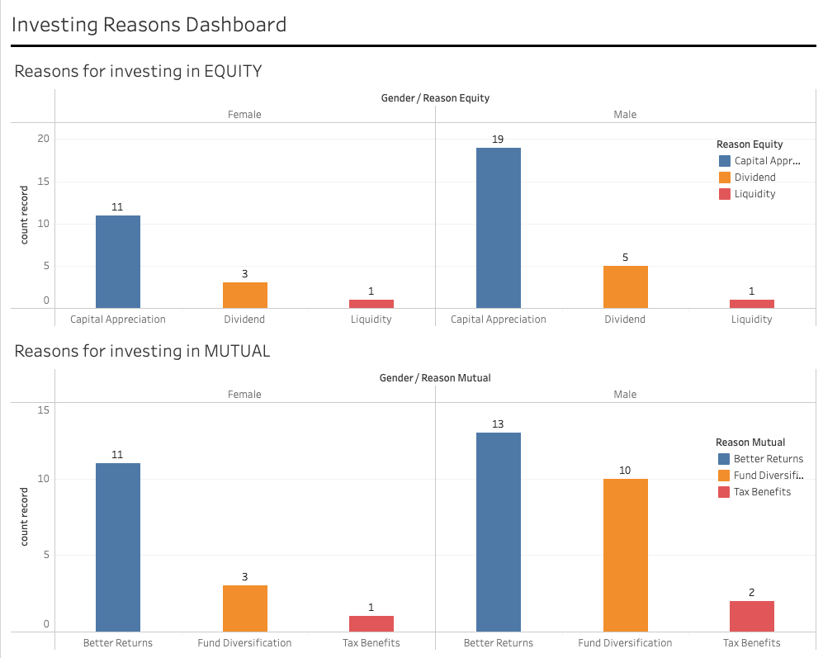

Slide 15
KEY INSIGHTS
Savings Objectives
Sources of Financial Advice
Across all age groups, retirement planning is the top savings objective (36%), followed by healthcare savings (25%). However, younger investors prioritize wealth accumulation and home purchase more than retirement.
Financial Consultants is the leading source of financial Information (40%), while others investors rely more on Newspapers & Magazines (35%) and Television (15%).

Slide 16
Summary of Findings
The analysis highlights distinct investment preferences across age groups and genders, with mutual funds and equities being the most popular among younger investors.
Retirement planning and healthcare are the primary objectives for savings, particularly among aged investors, while younger groups focus on wealth accumulation and home ownership.
Sources of financial advice vary significantly, with younger investors preferring online platforms and older investors relying more on financial consultants.
Overall, the insights provide a comprehensive view of investor behavior, offering potential opportunities for targeted marketing and product development.

Slide 17
Actionable Business Recommendations
Targeted Marketing: Focus digital marketing efforts on younger investors by promoting mutual funds and equities, emphasizing short-term investment flexibility. For aged investors, promote safer, long-term investment options like fixed deposits and bonds.
Product Development: Develop hybrid investment products tailored to younger investors that combine digital accessibility with diversified investment options, such as mutual fund-equity bundles.
Customer Engagement: Implement personalized financial advisory services for older investors, combining traditional consultant-driven approaches with digital tools for easier monitoring of investments.
Education Campaigns: Launch educational content aimed at younger investors to raise awareness about the benefits of long-term investments and retirement planning.

Slide 18
Future Opportunities
Further research could analyze the correlation between income levels and risk preferences, exploring how different financial backgrounds influence investment decisions.
Expanding the dataset to include factors like risk appetite, investment returns, and behavioral patterns over time could provide deeper insights into investor needs.
Exploring cross-regional differences in investment behavior might reveal additional market segmentation opportunities.

Slide 19
CONCLUSION
In conclusion, the analysis provides clear evidence of varying investment preferences across demographics, highlighting the need for tailored marketing strategies and product offerings.
The insights suggest that younger investors are more inclined to take risks with equities and mutual funds, while aged investors prefer the stability of bonds and fixed deposits.
By leveraging these insights, businesses can improve customer engagement, develop better financial products, and ultimately drive growth.

Slide 20
THANK YOU
Presented by TAMIZHSUDAR N
Github

